Slide 1

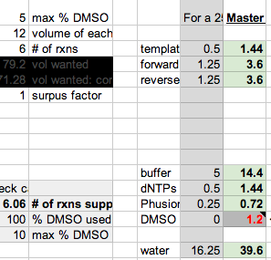
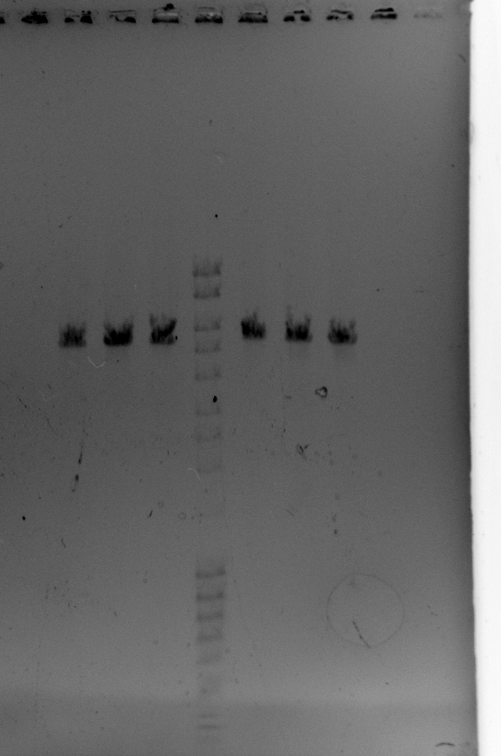
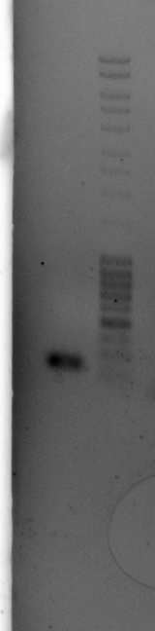
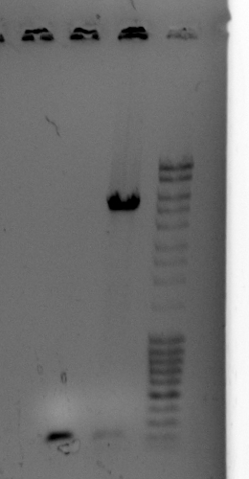

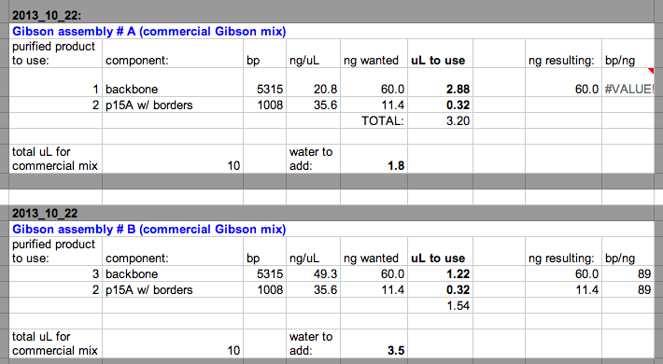
Make 30 uL of well 4, which looked great.
Did, but then well 13 looked bad in gel. Had already done assembly A. Made 30uL of well 4 again, and it looked good.
Well 14
Well 13

Slide 2

